Slide 1

ANNAMALAI UNIVERSITY
FACULTY OF ENGINEERING AND TECHNOLOGY
DEPARTMENT OF INFORMATION TECHNOLOGY
Smart Hybrid Fault Node Detection in Environmental Monitoring Wireless Sensor Networks
Teammates :
Gunasekaran G - 2238010015
Hariranjandass M B - 2238010018
Yuga Bharath D - 2238010061
Ajith A - 2338080001
Coordinated by:
Dr. D. Suresh,
Assistant Professor,
Department of Information Technology,
Annamalai University.
Supervised by :
Dr. K. Selvakumar,
Professor,
Department Of Information Technology,
Annamalai University.

Slide 2
Modules
Sensor Data Collection & Simulation
Data Preprocessing & Feature Engineering
Hybrid Fault Detection Engine
ML Training, Evaluation & Storage
Server, Database & Dashboard
10

Slide 3
Module – 3 Hybrid Fault Detection Engine
Overview & Objectives
What it does :
• Acts as the core decision-making brain of the system.
• Accurately classifies the current state of a sensor node as Healthy, battery_low, link_loss, or sensor_fail.
The Problem it Solves:
• Single detection methods fail. Rules are rigid, statistics miss context, and pure ML is computationally heavy.
The Hybrid Solution:
• Runs incoming data through Rule-Based, Statistical, and ML Engines simultaneously for maximum accuracy.

Slide 4

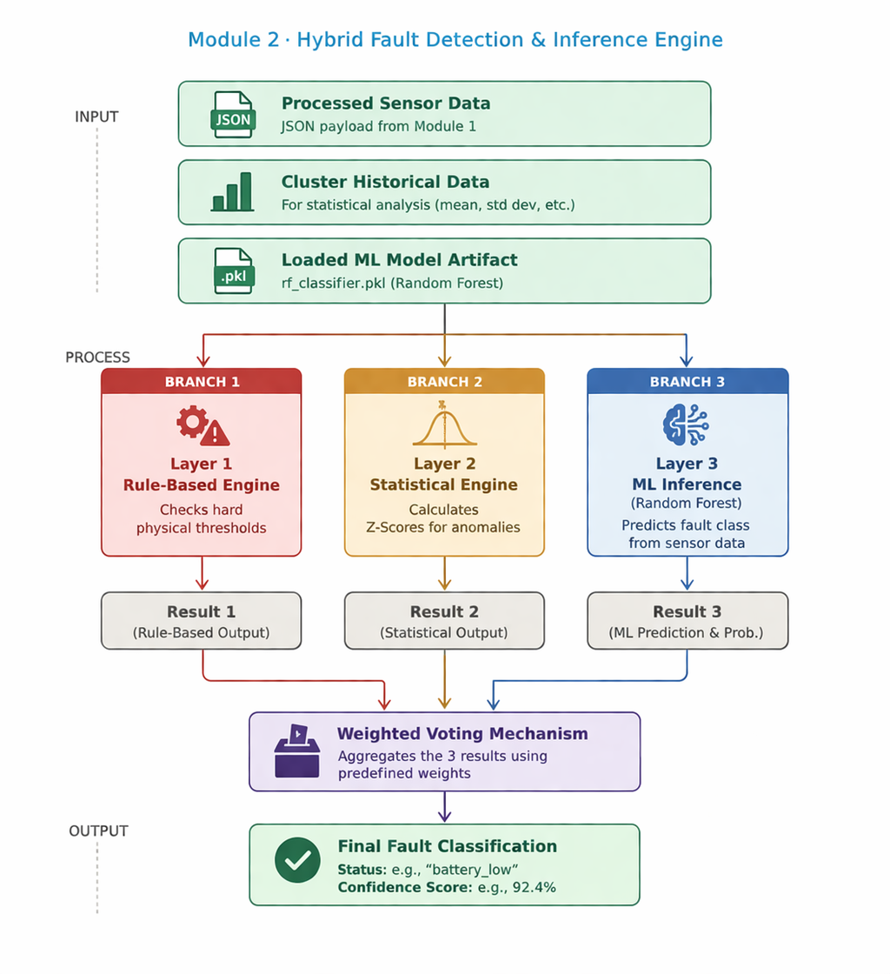

Flowchart structure

Slide 5
Layered Execution & Voting
How it works (The Three Layers):
• Layer 1 (Rules): Uses simple IF/THEN conditional logic for extreme, obvious hardware failures.
• Layer 2 (Statistics): Computes Z-Score against a rolling window of cluster data. Flags anomalies > 3 std devs.
• Layer 3 (Machine Learning): Passes 19 features through Random Forest to uncover hidden, complex patterns.
How it runs (Weighted Voting):
• Rule Layer Weight: 30%
• Statistical Layer Weight: 30%
• ML Layer Weight: 40% (highest priority for complex feature understanding)
• System sums the weights for each predicted fault type. The highest total weight wins.

Slide 6
Outputs:
======================================================
Hybrid Fault Detection Engine Initialized
Loaded Model: rf_classifier.pkl (Accuracy: 96.5%)
Voting Weights: [Rule: 0.3 | Stat: 0.3 | ML: 0.4]
======================================================
[Incoming] Node 12 | Cluster 2 | Temp: 24.5 | Battery: 85%
Layer 1 (Rule) : none
Layer 2 (Stat) : none
Layer 3 (ML) : none
>> Result: Node 12 is HEALTHY (Confidence: 1.0)
[Incoming] Node 04 | Cluster 1 | Temp: -12.0 | Battery: 62%
Layer 1 (Rule) : sensor_fail
Layer 2 (Stat) : sensor_fail
Layer 3 (ML) : sensor_fail
>> Result: FAULT DETECTED -> sensor_fail (Confidence: 1.0)
[Incoming] Node 31 | Cluster 4 | Signal: -95dBm | PDR: 0.72
Layer 1 (Rule) : link_loss
Layer 2 (Stat) : none
Layer 3 (ML) : link_loss
>> Result: FAULT DETECTED -> link_loss (Confidence: 0.7)

Slide 7
Module -4 ML Training, Evaluation & Storage
What it does:
Builds, trains, validates, and saves the Machine Learning model that powers Layer 3 of the Hybrid Engine.
Handles data imbalance (since faults happen much less frequently than healthy readings).
Serializes the trained 'brain' for real-time deployment without needing constant retraining.
Algorithm Choice:
Random Forest Classifier: Chosen because it is an ensemble method highly resistant to overfitting and excellent at handling the non-linear nature of IoT/WSN data.

Slide 8

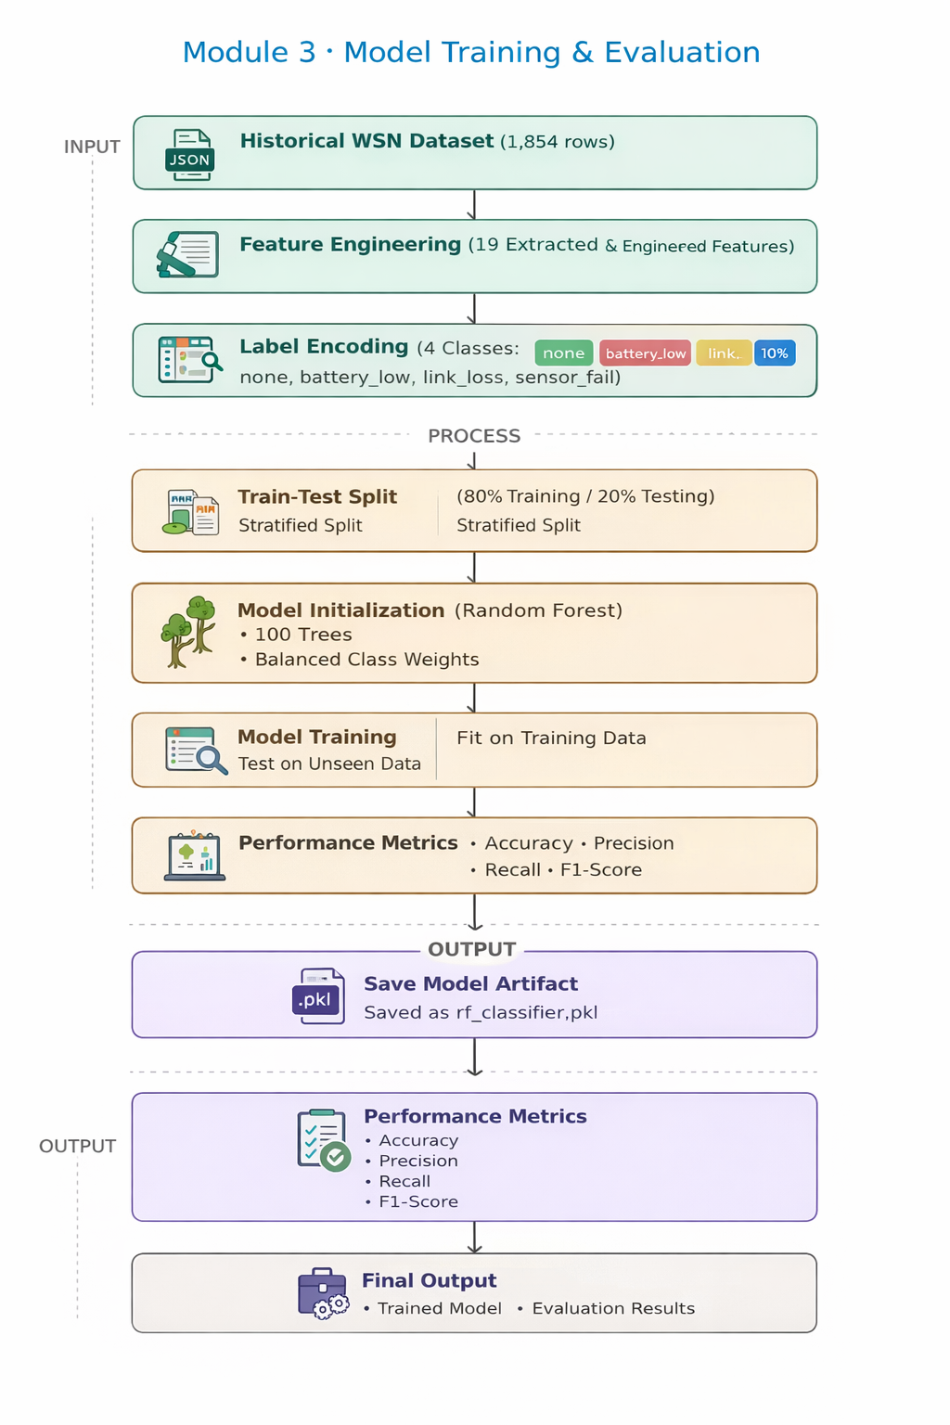



Flowchart

Slide 9
How it Works:
How it works (Training Phase):
Splitting: Data is split using Stratified Sampling to ensure the rare faults appear in both training and testing sets equally.
Class Balancing: Applies class_weight='balanced' during initialization to penalize the model heavily if it ignores minority fault classes.
Fitting: The algorithm builds 100 decision trees based on the features, learning the mathematical thresholds that separate healthy data from faulty data.
How it runs (Evaluation & Serialization Phase):
Passes the 20% Test Split through the trained model.
Calculates Accuracy (~96.5%), Precision (False Positives), and Recall (False Negatives - crucial for WSN safety).
Uses joblib library to serialize the model into a physical .pkl file on the hard drive.

Slide 10
Outputs:
======================================================
WSN ML Model Training Pipeline
======================================================
Initializing Random Forest Classifier...
Training model on feature matrix... (1483 samples)
Model training completed in 1.45 seconds.
Evaluating Model Performance...
Overall Accuracy: 96.50%
Classification Report:
precision recall f1-score support
battery_low 0.95 0.98 0.96 18
link_loss 0.93 0.95 0.94 19
none 0.98 0.97 0.97 316
sensor_fail 0.90 0.88 0.89 17
accuracy 0.96 370
macro avg 0.94 0.94 0.94 370
weighted avg 0.97 0.96 0.96 370
Model and Scaler successfully saved to disk.

Slide 11
Module -5 Server, Database & Dashboard
What it does:
Provides the central infrastructure that connects the sensor nodes, runs the detection engine, stores the data securely, and presents it visually.
Translates raw data and machine learning predictions into a human-readable format for network administrators.
Components:
REST API Server (Flask): The communication bridge catching live node data.
Database (SQLite): Persistent historical storage for telemetry and fault logs.
Web Dashboard (HTML/JS): An interactive, real-time graphical user interface.

Slide 12
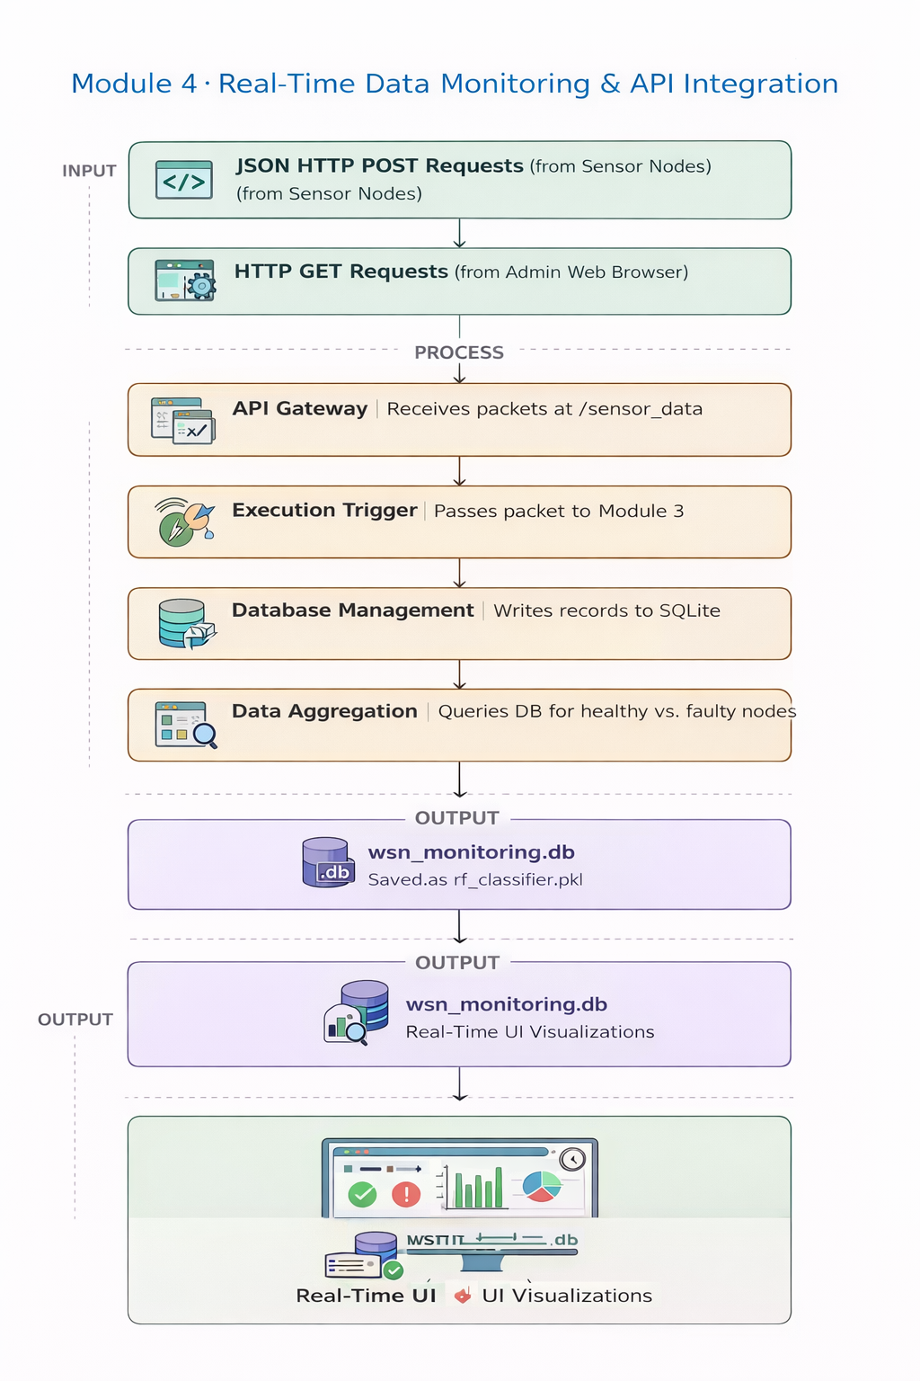
Flowchart

Slide 13
How it Works:
How it works (Backend & Database):
Uses Python's Flask framework for high speed and low overhead.
Exposes a POST /sensor_data endpoint. When a node transmits data, the server extracts the JSON and hands it to the Hybrid Engine.
Once a fault status is returned, the server executes an INSERT INTO SQL command to save the record in SQLite for future audits and model retraining.
How it runs (Frontend Dashboard):
Employs asynchronous JavaScript (AJAX).
Every 3 seconds, the browser sends a GET /api/network_status request to the server in the background without reloading the page.
The server queries the SQLite database, groups the data by fault type, and Chart.js instantly animates the graphs to reflect the live network status.

Slide 14
Outputs:
* Serving Flask app "WSN_Dashboard" (lazy loading)
* Environment: production
* Debug mode: on
* Running on [http://127.0.0.1:5000/](http://127.0.0.1:5000/) (Press CTRL+C to quit)
* Restarting with stat
* Debugger is active!
[13/Mar/2026 10:45:12] "GET / HTTP/1.1" 200 - (Dashboard Loaded)
[13/Mar/2026 10:45:14] "POST /sensor_data HTTP/1.1" 200 - (Node 5)
[13/Mar/2026 10:45:14] "POST /sensor_data HTTP/1.1" 200 - (Node 12)
[13/Mar/2026 10:45:15] "GET /api/network_status HTTP/1.1" 200 - (Dashboard Refresh)
[13/Mar/2026 10:45:16] "POST /sensor_data HTTP/1.1" 200 - (Node 31 - FAULT LOGGED)
[13/Mar/2026 10:45:16] "POST /sensor_data HTTP/1.1" 200 - (Node 8)

Slide 15
Complete System Execution:
Step-by-Step Flow (Sub-second execution):
Anomaly Occurs: Node 14 experiences a physical drop in signal strength (Simulated in Mod 1).
Transmission: The Node packages this data and sends a JSON POST Request to the Flask Server (Mod 5).
Routing: The Server catches the data and routes it to the Hybrid Engine (Mod 3).
Tri-Layer Check:
  Layer 1 sees signal is weak.
  Layer 2 sees latency is higher than the cluster average.
  Layer 3 (Mod 4 ML) mathematically confirms a highly probable link_loss.
Decision: The Weighted Voter finalizes the status as link_loss.
Logging: The Server saves this record to the SQLite database.
Visualization: The AJAX Dashboard polls the server, sees the new fault, and instantly turns a node indicator red on the UI.

Slide 16
Thank You!

